Slide 1
Separating Substances and Other Equipment

Slide 2
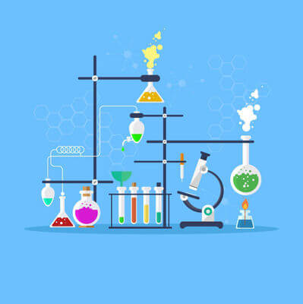
In this Smart Lesson you will learn how to:
Identify different types of equipment and their uses in science.

Slide 3
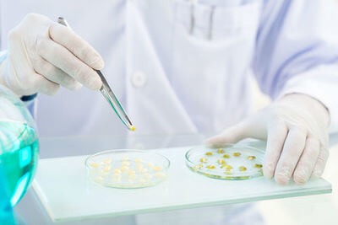
Tweezers are used to pick up and move very small things in the lab.

Slide 4
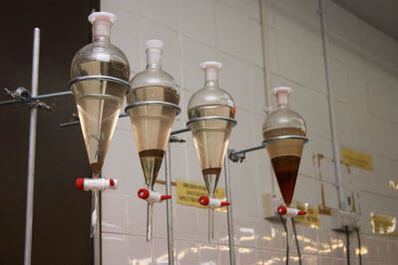
Separating funnels are used to separate liquids that do not mix, such as oil and water.

Slide 5
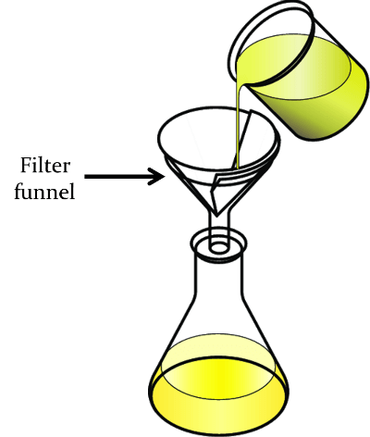
Filter funnels are used to separate solids from liquids.
The liquid passes through the filter leaving behind the solids in the filter paper.

Slide 6
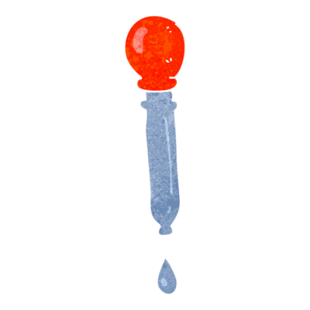
Droppers are used when we want to measure out a very small amount of liquid.

